Slide 1
Decibel: Isolation and Sharing in
Disaggregated Rack-Scale Storage
Mihir Nanavati, Jake Wires, and Andrew Warfield
(Coho Data and University of British Columbia)

Slide 2






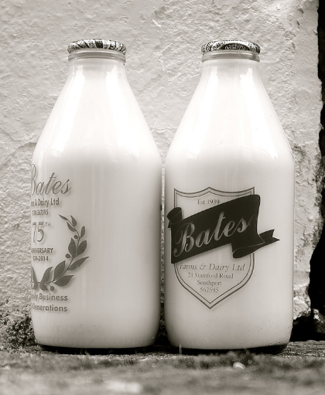




Redundancy and high availability
Transparent device aggregation
Cluster-accessibility
Decoupling and migration

Slide 3

Splendid cheeses they were with a two hundred horse-power scent that might have been warranted to knock a man over at two hundred yards.
Extract from “Three Men in a Boat”, Jerome K Jerome (1889)

Slide 4



“… because the data is remote (and often replicated under the covers), there’s typically a noticeable latency cost involved in using it rather than local storage [...] the ideal would be to use local disk for each replica for the sake of lower latency.”
Low throughput
Latency overheads
Shared ➔ Crosstalk
“EBS has got a lot better ... [At Netflix] we [still] don't quite trust it for Kafka workloads […] going for instance type”
“… unless you want to add more complexity for your operations team, choose […] direct-attached storage ….”

Slide 5
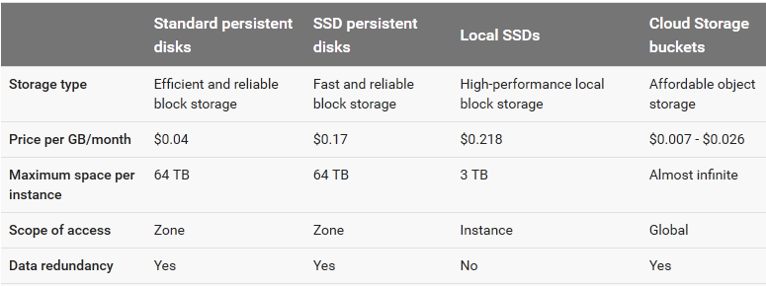
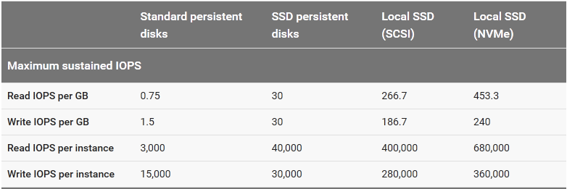

Slide 6
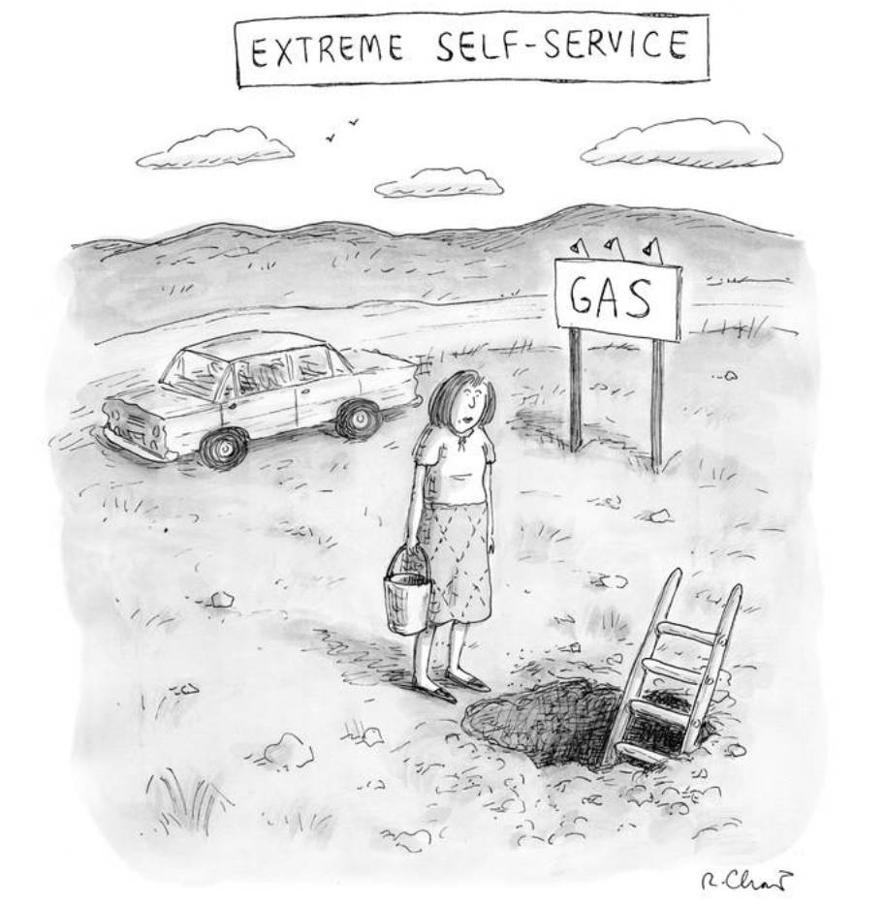
“[with Local SSDs] You cannot stop and restart an instance … only suitable for temporary storage ...”
(Roz Chast, The New Yorker, April 2001)

Slide 7
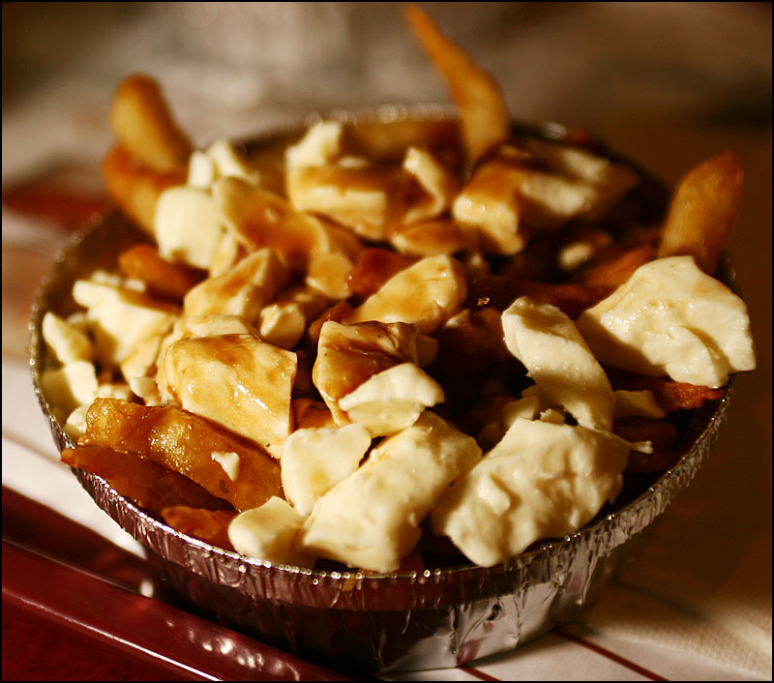

Slide 8

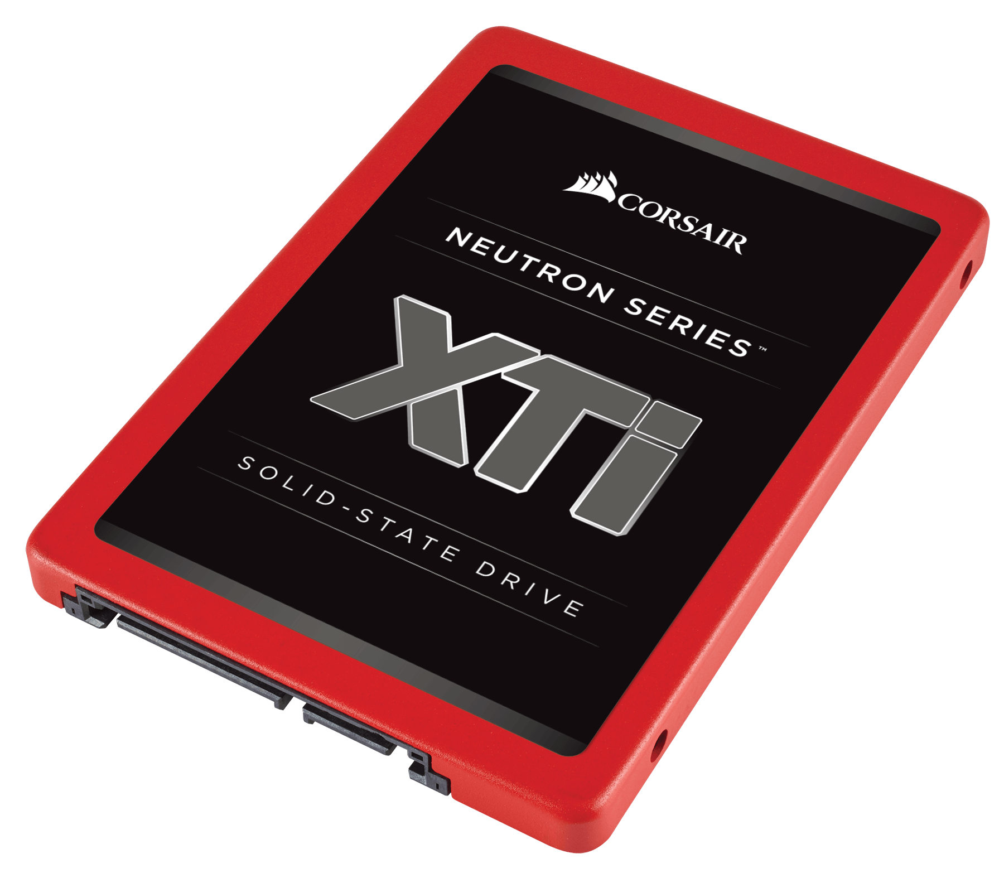
decibel storage goals
vs.
Managed Storage
Local Storage
Redundancy and high availability
Transparent device aggregation
Cluster-accessibility
Decoupling and migration
Throughput and latency
No crosstalk
Tight host coupling

Slide 9
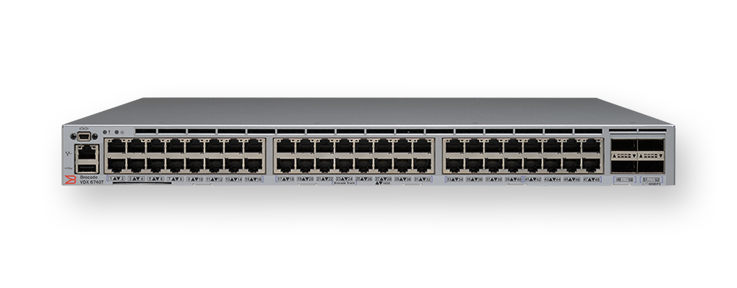
Compute Drawer
Make all local storage cluster-accessible!
Storage Brick
(Adapted from Intel Rack Scale Architecture)

Slide 10
Decibel is a storage service that remotely serves “local” storage
Challenges
Workload dynamism
Virtualization
Maintain device performance
Virtualized Storage Abstraction + Runtime

Slide 11

“They are neither man nor woman
They are neither brute nor human
They are Ghouls”
Extract from “The Bells”, Edgar Allan Poe (1849)

Slide 12
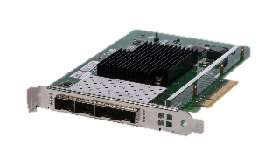
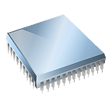


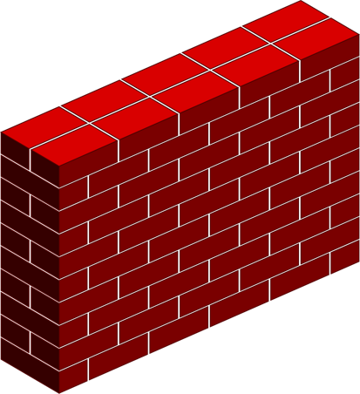
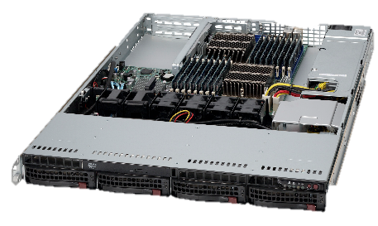

dVols
Network
Boundary
Decibel Runtime
read(block_addr, len)
Virtual device
Virtual Machines
Full-system resources
Hardware-like interfaces
Isolation and sharing
Multiplex on fast hardware!
Network Storage Service
Runs locally
on
Preserve device performance
Performance isolation
Access control
Virtualizing only the capacity of devices is insufficient!
Vertical slice of the entire system
Virtual device
From the application perspective, storage resembles a network-attached disk
Client Library
TCP-based RPC
dVols

Slide 13


N:1 multiplexing
User space
Volume
Volume
Volume
Core
dVol
dVol
dVol
Core
Core
Decibel Logic
TCP
Block I/O
DPDK
SPDK
Virtualization and Scheduling
Kernel
Hardware Queues
OS Thread
TCP: seq 82165
TCP SYN
Flow Director

Slide 14
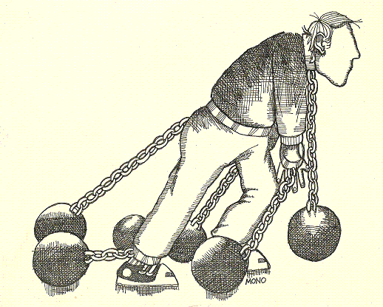
Decouple placement from scheduling
(Mirador, FAST 2017)
(PD Lankovsky)
Capacity Migrations
dVols are bound to a single core and a single device
Performance Migrations
Limits mimic local SSDs

Slide 15
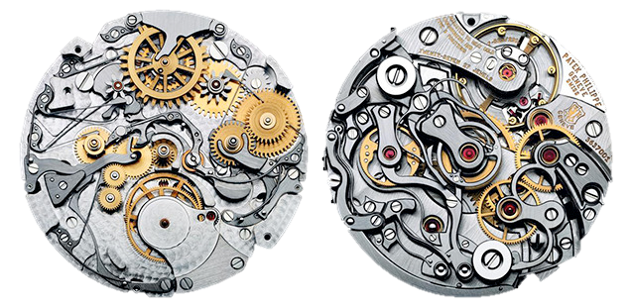
Device Partitioning
Contention and fragmentation
Per-core caches (Hoard/tcmalloc)
Scheduling
Device throughput and latency
dVol isolation
(Guido Mocafico, Movement)

Slide 16
Throughput (K IOPS)
Latency (μs)
Single Device, 4K Mixed (70/30) RW
dVols provide hooks for conveniently implementing policies
No Isolation (FCFS)
Regular Client (A)
Fair Share (30%)
Regular Client (B)
Bursty Client
Time
Decibel (DRR)
Time

Slide 17
the decibel runtime
Resource Management
Scheduling
Address Virtualization
Access Control
Atomicity and Data Integrity

Slide 18
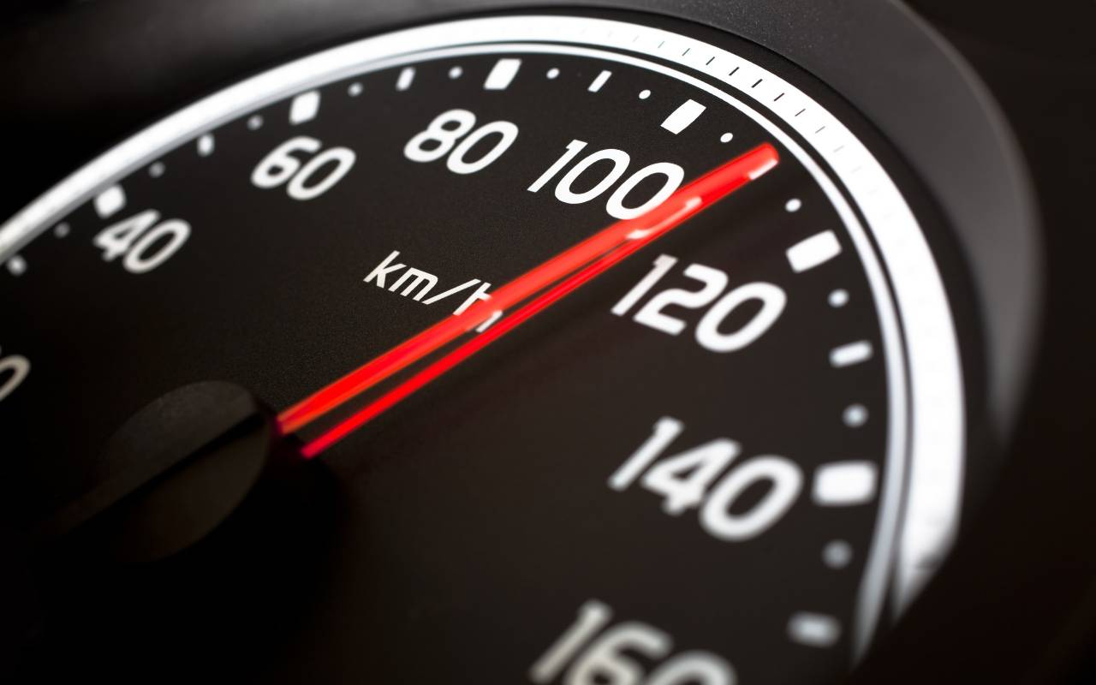
Decibel vs. Local Devices
Single-core Performance
Performance

Slide 19
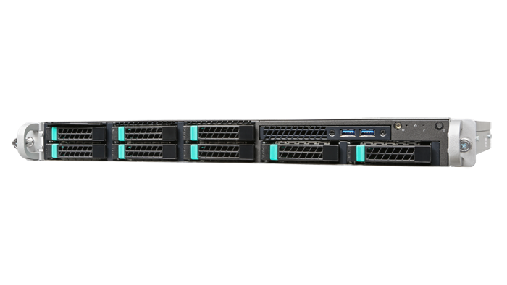
the setup
1U Client
2 x Fortville 40GbE
Clients/Core : 2
QD/client : 16
4K random requests
Independent remote dVol
1U Server
4 x P3700
2 x Fortville 40GbE
1.8 M IOPS (60 Gbps)

Slide 20
Performance (70/30 Mixed Workload)
Throughput (K IOPS)
Latency (μs)
422 vs 450 vs 490μs
Number of Cores
Number of Cores

Slide 21
Performance (All Reads Workload)
Throughput (K IOPS)
Latency (μs)
203 vs 221 vs 290μs
Number of Cores
Number of Cores

Slide 22
single core performance
Latency (μs)

Slide 23
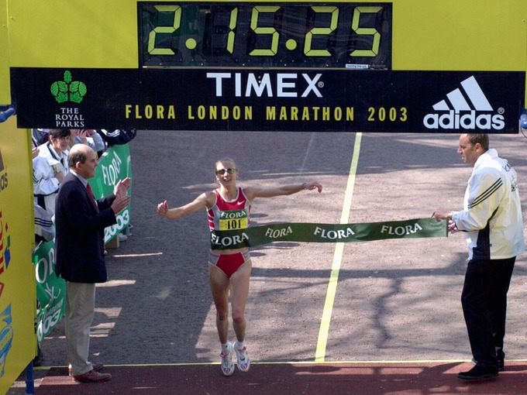
Local storage as a service
Encapsulate full-system resources
20-30μs overhead to local devices
Isolation on shared storage

Slide 24
Backup Slides

Slide 25
Performance (DRAM Backed Storage)
Throughput (K IOPS)
Latency (μs)
Saturation: 23 vs 68μs
Number of Cores
Number of Cores

Slide 26
latency consistency (reads)
Latency (μs)
Throughput (K IOPS)
Queue Depth

Slide 27
latency consistency (writes)
Latency (μs)
Throughput (K IOPS)
Queue Depth

